Slide 1
Responsible AI in a Defence Context
Digital Academy
April 18, 2019
Michael Karlin, Team Lead, Policy and Strategy
ADM (Data, Innovation, Analytics)

Slide 2
Let’s talk about…
AI in a defence context
Ethics, laws, and rules
Use cases

Slide 3
AI in a Defence Context

Slide 4
Breaking down “AI”
Perception
Identify features of faces, images, handwriting, or sounds
Reasoning
Detecting patterns in data and predicting outcomes based on those patterns, or providing a recommendation for a course of action
Human-machine interaction and teaming
Interact with humans using natural language, by voice or text, and understanding insights from that language, including understanding emotion. Team with robotic devices to share mission tasks
Autonomous (or semi-autonomous) platforms
Sensors and effectors exploiting robotic technologies
Notes:
30s

Slide 5
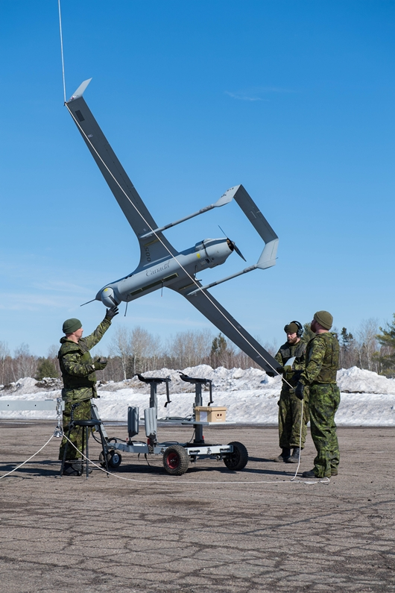
Opportunities for AI in defence
Command
Mission resource optimization
Risk assessment and option analysis
Sense
Object detection
Sensor network optimization
Act
Semi-autonomous weapon systems
Human-machine teaming
Shield
Autonomous robots for CBRN defence
Adaptive network defence
Sustain
Robotic field surgery
Autonomous convoy and resupply
Personalized training plans
Notes:
30s

Slide 6
AI at DND/CAF is a team sport…
Policy
Strategic policy
Geopolitical analysis
International Relations
New capability R&D and model development
Research funding
Service and Support
Branches
Ethics
Data quality
Governance
DRDC
Operational standards
DIA
Supporting
Prototyping
Model development
JAG / Review Services
Cybersecurity
Interoperability
Infrastructure
* A work in progress
IM

Slide 7
…but the model is useful beyond defence.
Policy
Strategic policy
Environment analysis
International Relations
New capability R&D and model development
Research funding
Service and Support
Branches
Ethics
Data quality
Governance
R&D
Operational standards
CDO
Supporting
Prototyping
Model development
Interoperability
Legal / Evaluation / V&E
Infrastructure
Cybersecurity
* This is multidisciplinary work
CIO

Slide 8
Ethics, Laws, and Rules

Slide 9
Law
Constitutional law
Privacy law
Administrative law
Enabling legislation (e.g. National Defence Act)
Ethics
Maximizing good (beneficence) and minimizing harm (maleficence)
To who/what?
Subjectivity?
Use:
To interpret rules,
When no rules exist,
To override rules (be cautious)
Administrative Policy
Treasury Board policy instruments
Defence Administrative Orders and Directives
Operational Standards
Data quality
Human-robotic interaction
User interface
Etc…

Slide 10
Public sector ethics are not subjective…
DND and CAF V&E Code
Values and Ethics Code for the Public Sector
Respect the dignity of all persons
Serve Canada before self
Obey and support lawful authority
Integrity
Loyalty
Courage
Stewardship
Excellent
Respect for democracy
Respect for people
Integrity
Stewardship
Excellence

Slide 11

DRDC AI Ethical Framework
Compliance with DND and CAF Code of Values and Ethics
Common values and expected behaviors that guide CAF members and DND employees
2. Compliance with Jus ad Bellum Principles
Criteria to be met before entering a conflict so that all conflicts are justified
3. Compliance with Law of Armed Conflict/Jus in Bello Principles
International laws that must be followed during times of conflict
4. Health and Safety Considerations
Questions about direct and indirect impact of AI or robotic technologies on soldiers’ and civilians’ physical and psychological well-being
5. Accountability and Liability Considerations
Questions about risk and responsibility for AI- and robotictechnology failures as well as unanticipated and/or undesired effects
6. Privacy, Confidentiality, and Security Considerations
Questions about sharing, storing, protecting and using information obtained by AI technologies

Slide 12

DRDC AI Ethical Framework
7. Equality Considerations
Questions about the influence of AI and robotics on fairness and functionality within the CAF and society
8. Consent Considerations
Questions about consent to, or approval of, AI technologies
9. Humanity Considerations
Questions about the impact of AI and robotic technologies on morality, personal responsibility, and human dignity
10. Reliability and Trust Considerations
Questions about trust in AI-enhanced technologies and human/machine interactions
11. Effect on Society Considerations
Questions about how the use of AI-enhanced and robotics technologies could affect civilians; how civilians could respond to these technologies
12. Considerations Regarding Preparedness for Adversaries
Questions about the use of AI-enhanced technologies and robotics by our adversaries, and how our adversaries may view our use of these tools

Slide 13
Ethical deliberation
What benefit is this bringing? What harm is being mitigated?
To/against whom? To what extent? For how long? Is this systematic or one-off? Historical considerations?
Are benefits/harms easily detectable? By whom? Are they measurable? How strong a correlation between the activity and the outcome?
Are benefits or harms affected by the timeliness of action? (i.e. will “moving fast and breaking things hurt someone?”) Would inaction bring or further harm?
Are these arbitrations consistent? Accountable? Transparent? Able to be challenged?
…there is no easy checklist. This can’t be automated. This is hard work.

Slide 14
Use Cases (ALL of these are hypothetical)

Slide 15
Predictive naval maintenance
Analytics to predict whether ship repair will be completed on time, which will inform international commitments and force readiness.
Career management of military personnel
Analytics to predict potential ability in certain military trades, or in command acumen. Career management decisions are based on these inputs, which can include training performance, psychometrics, health information.
Lethal Semi-Autonomous UAV
UAV capable of engaging a specific target, identified using facial recognition and verified over a human-designated confidence level, within a human-designated space and time.

